Slide 1



By Deano B0091839@student.itb.ie
Welcome To the HackerSoc
Ethics + hacking methodology + setting up kali linux

Slide 2
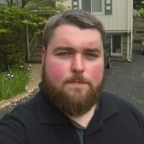
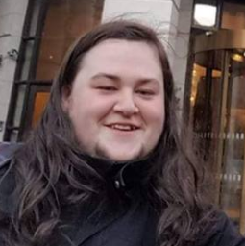
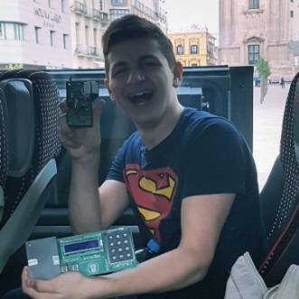
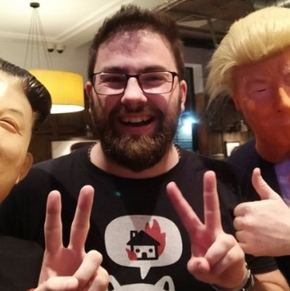

The Team
Dean O’ Neill
CEO
Alan O’ Riley
Secretary
Victor Azzam
Sys-Admin
Paddy Kerley
Student Contact
Luke Quigley
Accountant

Slide 3




The Soc
What is the Society
it’s a place for you to learn and make like minded friends, its how I got my job
Social media
@HackerSoc
www.hackersoc.com discord.gg/fT8nftZ
Social
Social Nights in “The GrateWood Weatherspoons” Blanchardtown
Were All Nerds
Some of us Hang out in D Block playing Magic, Gaming, D&D or just talking crap, come say Hi
Soc Trips and Randomness
To visit Conferences around Ireland CTFs, going abroad or even down to LesuirePlex bowling

Slide 4
The Plan
Hopefully to Have 2 Meetings a week, even more
1 – A mini hacking course to teach enough for CTFS “ZeroDays”
2 – A Talk Topic on OPSEC, Security or Tools
3 – If you Have a Talk and Want to give it Awesome ☺
2 x Capture the Flag Events – With Prizes
A Monthly Social – 1st Last Friday before Oct reading week “Halloween, Fancy Dress”
Movie Evenings if we get rooms “Hacker Teamed Movies”
Stickers and Hoodies – How Many Would be Interested

Slide 5



The Sponsors

Slide 6
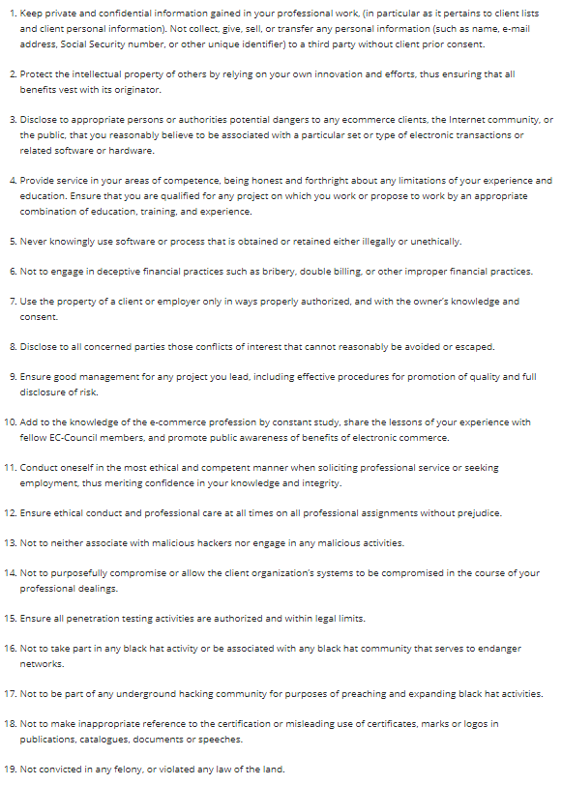

Ethics

Slide 7
College Rules
No Hacking on College Systems or Networks
No VIRUS’s On College Systems or Networks
Do Not Attack Lectures
Do Not Attack Students
No Leaking Of Personnel Details “Doxing”
Follows Irish Laws “Offenses Relating To Information Systems Act 2017”
Cyber Crime on Campus will be referred to An Garda Síochána
The Irish Law
https://tinyurl.com/ya3k4aso

Slide 8
Ethical Hacker Society Rules
There is A No Strikes Policy In The Soc
Caught Hacking on Campus or even off campus you will get a Life Ban
Anything Learned In the Soc Stays in the Soc
Don’t use what you learned Maliciously
Don’t Make a show of the soc
Don’t do what you normally wouldn’t a Spoons or Events
You are Yourself
If you are unsure about something ASK!!!

Slide 9
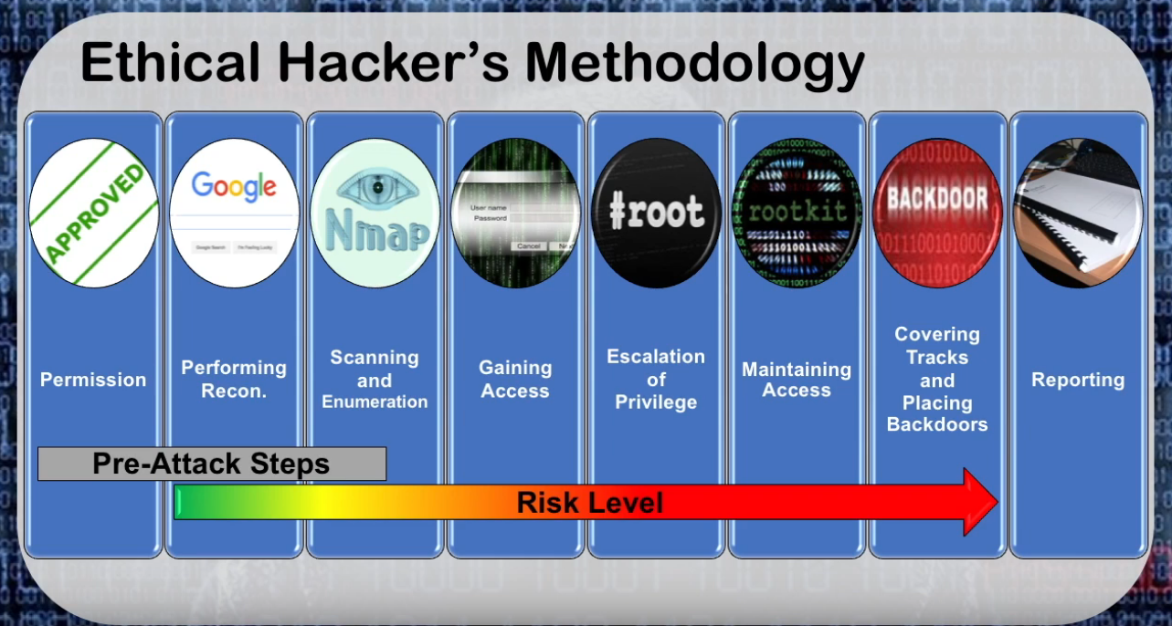
The Hacking Methodology
Stages
1st Permissions
2nd Foot printing
3rd Scanning
4th Exploitation
5th Privilege Escalation
6th Maintaining Access
7th Covering Tracks
8th Reporting

Slide 10
Setting Up Kali Linux
What you Need !!!
A Working laptop ?!?!
15gbs of free storage space – Recommend 30+
Minimum of 512mbs of ram – Recommend 8+
Ability to use Network connection

Slide 11
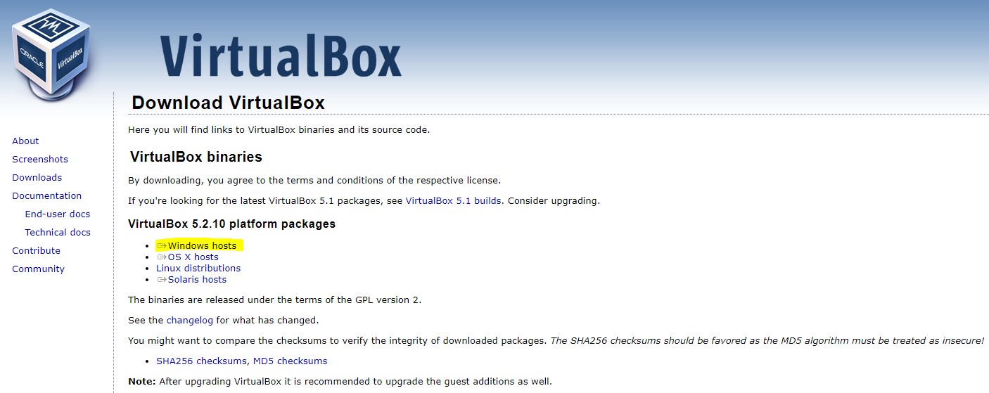
https://tinyurl.com/5vgw4mp

Slide 12
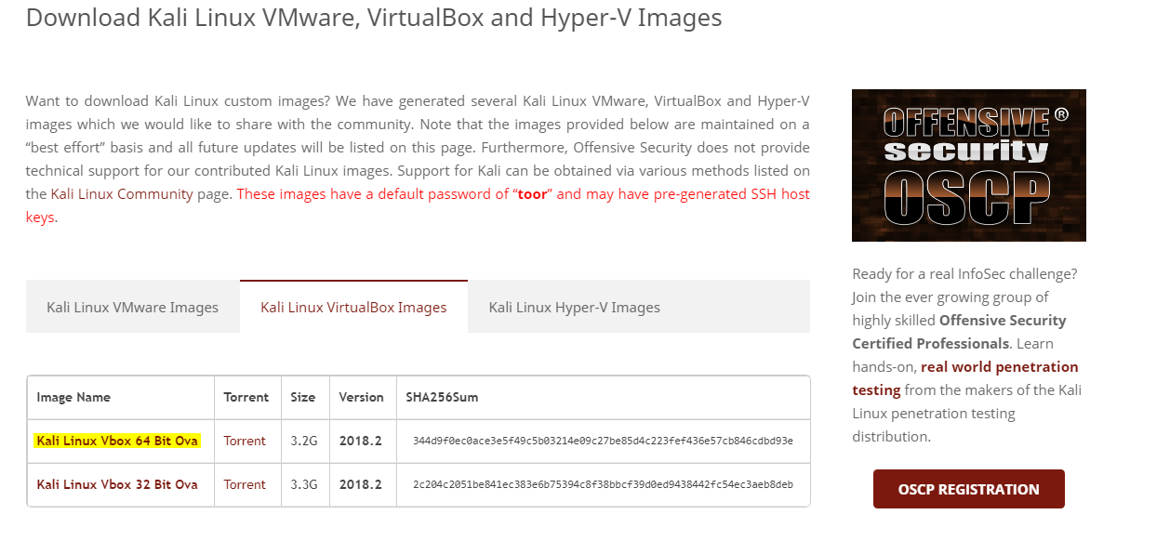
https://tinyurl.com/ycbz3grw

Slide 13
Double Click on the Kalilinux.ova
It will Auto install in virtual Box
Start the Virtual Machine clicking the play button
Login with username = root & password = toor

Slide 14
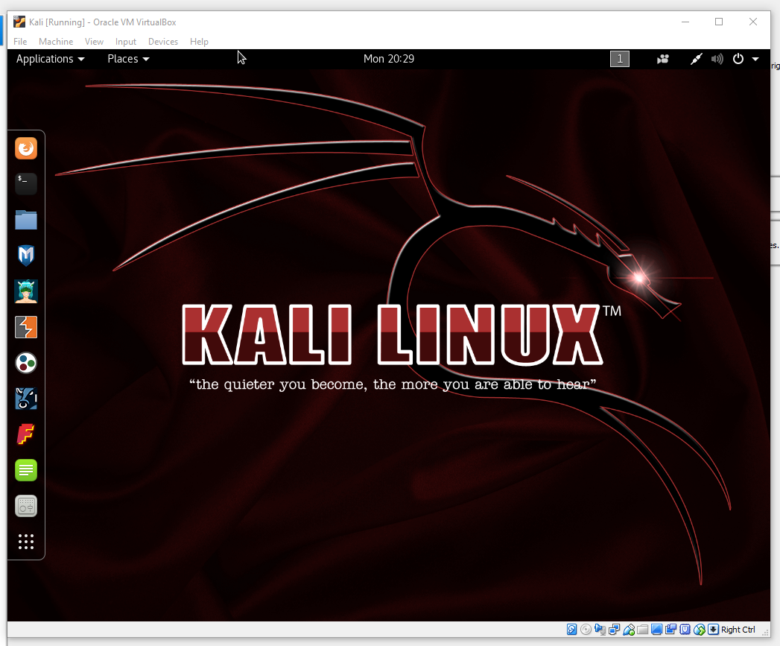

Slide 15
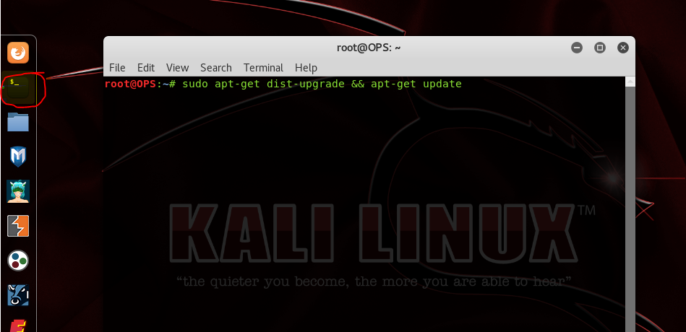
Sudo apt-get dist-upgrade && apt-get update

Slide 16


